Slide 1
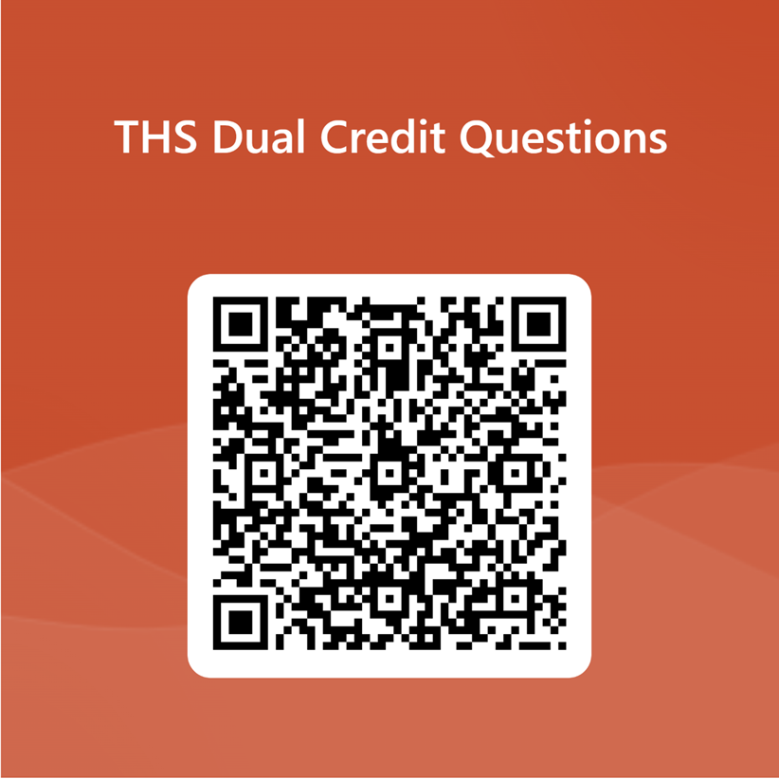
Let’s Talk Dual Credit
Veronica Martin-Perkins
Lead Counselor and Dual Credit Coordinator
Please scan QR code to submit questions

Slide 2
Travis High Counseling Department
Ms. Martin-Perkins
Lead Counselor
Ms. Andrews
Last Name J- Mar
Mrs. Clark
Last Name Mas- Pap
Ms. Young
Last Name Par-Sim
Ms. Adelstein
Last Name Sin- Z
Ms. Crawford
Last Name A-Bo
Mr. Brodrick
Last Name Br-Es
Ms. Williams
Last Name Et- I
Ms. Martinez
College and Career Advisor
Counseling Clerks
Ms. Gibson and Mrs. Khan

Slide 3
What is Dual Credit?
A system in which an eligible high school student successfully completes a college course that is paired to a high school course and receives credit for the course on both the college and the high school transcripts.
Can be taught on the high school campus by a FBISD teacher who is also employed by Houston Community College OR by an HCC professor. Students can also take the class directly at HCC.
Dual credit courses are college classes first and high school classes second. Students and teachers are required to follow all HCC policies, i.e., attendance, grading, accommodations, academic honesty, etc.

Slide 4
Benefits of Dual Credit
Student will save on tuition and fees by reducing the time to complete a degree
Weighted credit on high school GPA (10 points!)
Student will receive college credit and high school credit simultaneously for successfully completing course.
Student graduates from high school with transferable college credits.
Student fast-tracks undergraduate or workforce degrees.
Student has access to a full range of college student support services while in high school to aid them in a smooth transition to college after graduation.

Slide 5
Are You Eligible To Take Dual Credit?
Students in 11th grade who meet TSI (Texas Success Initiative) or dual credit eligibility requirements may enroll in dual credit courses.
Eligibility can be based on any ONE of the following:
TSI assessment
SAT/ACT scores
PSAT/NMSQT scores
EOC Algebra I scores (and must have also successfully completed Algebra II)
EOC English II scores

Slide 6
Dual Credit Eligibility Specifics
EOC Scores (TSI Waiver) | PSAT/NMSQT Scores (TSI Waiver) | SAT Scores (TSI Exemption) | ACT Scores (TSI Exemption) | TSIA Scores
TSI DC Ready for Reading & Writing: English II EOC Score: 4000+ TSI DC Ready for Math: Algebra I EOC Score: 4000+ & Algebra II completion with a grade of C or better | TSI DC Ready for Reading & Writing: EBRW Score: 460+ TSI DC Ready for Math: Math Score: 510+ | TSI Ready for Reading & Writing: EBRW Score: 480+ TSI Ready for Math: Math Score: 530+ | Minimum Composite Score: 23, plus TSI Ready for Reading & Writing: English Score: 19+ TSI Ready for Math: Math Score: 19+ | ELAR: 945+ AND Essay 5; OR 910-944, Diag 5-6 AND Essay 5-8 Math: 950+; OR 910-949 AND Diag 6

Slide 7
FBISD Dual Credit Courses
FBISD Course | HCC Course | Grade Level | Term | Location
English IV | English Composition I & II (ENGL 1301 & 1302) | 12 | Summer I & II | HCC
 |  |  | Fall & Spring | High School Campus or HCC
US Government | American National Government (GOVT 2305) | 12 | Summer I or II | HCC, HCC Online
 |  |  | Fall or Spring | High School Campus, HCC (Grade 12 Fall Only)
Economics | Principles of Economics (Macro) (ECON 2301) | 12 | Summer I or II | HCC, HCC Online
 |  |  | Fall or Spring | High School Campus, HCC (Grade 12 Fall Only)
Independent Study Math | College Algebra (MATH1314 Only Spring term is dual credit | 12 | Fall / Spring DC | High School Campus ONLY
US History | US History to 1877 & US History after 1877 (HIST 1301 & 1302) | 11-12 | Fall & Spring | High School Campus ONLY
Psychology | Introduction to Psychology (PSYC 2301) | 11-12 | Summer I or II | HCC, HCC Online
 |  |  | Fall or Spring | High School Campus, HCC, HCC Online
Sociology | Introduction to Sociology (SOCI 1301) | 11-12 | Summer I or II Fall or Spring | HCC, HCC Online
Professional Communications | Public Speaking (SPCH 1315) | 11-12 | Summer I or II Fall or Spring | HCC, HCC Online
American Sign Language 1 & 2 | Beginning American Sign Lang (SGNL 1401 & 1402 | 9-12 | Summer 1 or II Fall or Spring | HCC
German 1 & 2 | Beginning German Language (GERM 1401 & 1402) | 9-12 | Summer 1 or II Fall or Spring | HCC, HCC Online
THS currently offers
English IV
College Algebra
Psychology
Sociology
US. Government
Economics
Next year, we hope to also offer
Speech
US History
Also, you can take approved classes on your own at HCC and still earn dual credit.

Slide 8
How is Dual Credit Applied at Your College?
Students should check with the institution they plan to attend for specific policies regarding the transfer of dual credit courses prior to enrolling in any course.
The transferring university will determine if only the course transfers or if the course and the GPA transfers.
Some 4-year institutions will not accept a grade of D in dual credit courses. It is important to work hard to earn an “A” or “B” in a DC. course.

Slide 9
How Much Does Dual Credit Cost?
A three-hour HCC course usually costs
$259.50 for in-district (inside of the HCC taxing boundary)
$547.50 for out-of-district (outside of the boundary)
However, FBISD will supplement the bulk of the cost for your dual credit courses
In-district FBISD students pay $0
Out-of-district FBISD students pay $65 (but the district might cover this as well)
Students are responsible for purchasing any required books or materials for their class.

Slide 10
How are Dual Credit Classes Graded?
HCC provides FBISD schools with grades each semester for all dual credit courses taken both at high school and HCC campuses (including online courses). No dual credit grades will show in Skyward during the semester.
The HCC/FBISD grading policy is subject to change pending FBISD BOT approval.
Earning below a “C” in a dual credit course could adversely affect FAFSA and financial aid eligibility following high school graduation, including scholarships, grants, and student loans.
Students with an HCC GPA lower than a 2.0 (C average) can be placed on academic probation or suspension.
Failing a dual credit course means a student is at risk of being denied financial aid for college after high school.
Students who fail a dual credit course will need to retake the course in high school (if required for graduation) as well as in college, at full cost.
DO NOT FAIL A DUAL CREDIT COURSE!

Slide 11
How are Dual Credit Classes Graded?
Grades for dual credit classes are not reported in Skyward and will only show up on the student’s high school transcript once the course is completed and grades received from the college.
Students have access to their dual credit grades during the semester by logging into the HCC Canvas platform.
HCC will issue a letter grade.
HCC’s grade will be converted, entered onto the student’s FBISD transcript, and calculated into the GPA as follows:
HCC Letter Grade | FBISD Grade for Course
A | 96
B | 86
C | 76
D | 70
F | 59

Slide 12
Dropping a Dual Credit Course
Students who drop a dual credit course during the first three (3) weeks of the HCC semester will be enrolled in the corresponding FBISD regular level course.
Students withdrawing from a dual credit course AFTER the first three (3) weeks of the HCC semester will be enrolled in the corresponding FBISD online credit recovery course.
Students who are sent to Ferndell Henry Learning Center will automatically be dropped/withdrawn from a dual credit course. Instruction is not available at the alternative campus, and attendance rules will not be met.
Students who drop/withdraw from a course are subject to a $15 administrative fee, payable to HCC.

Slide 13
Registration Process and Next Steps
Registration takes place in the spring semester prior to the summer or fall when you will be taking dual credit
Students MUST:
Attend a dual credit interest meeting (you’re doing this today!)
Enroll in the appropriate dual credit class during high school course selection (January 23-February 5)
Verify that you’re eligible to take dual credit
Apply to HCC as a dual credit student through Apply Texas and obtain an HCC ID #
Complete all dual credit paperwork on time-Available January 30, 2023
Pay attention to emails and messages received throughout the process

Slide 14
Important Dates to Remember
Course Selection –January 23-
February 5, 2023
1
Complete ApplyTexas by February 2, 2023
2
Submit paperwork by February 10, 2023.
3

Slide 15
Completed Paperwork
HCC Meningitis Vaccination Verification
HCC Dual Credit Waiver Approval Form
HCC FERPA Release Form
Student Commitment Statement
Current transcript (11th grade fall semester)
Qualifying College Readiness Scores: (only the
PSAT (8/9,10 or 11th grade CR scores)
SAT(11th grade students will test 3/1/2023)
Texas Success Initiative (TSI) –available for 11/12th grade DC interested students 4/1/2023

Slide 16
Please submit your questions here

